Slide 1




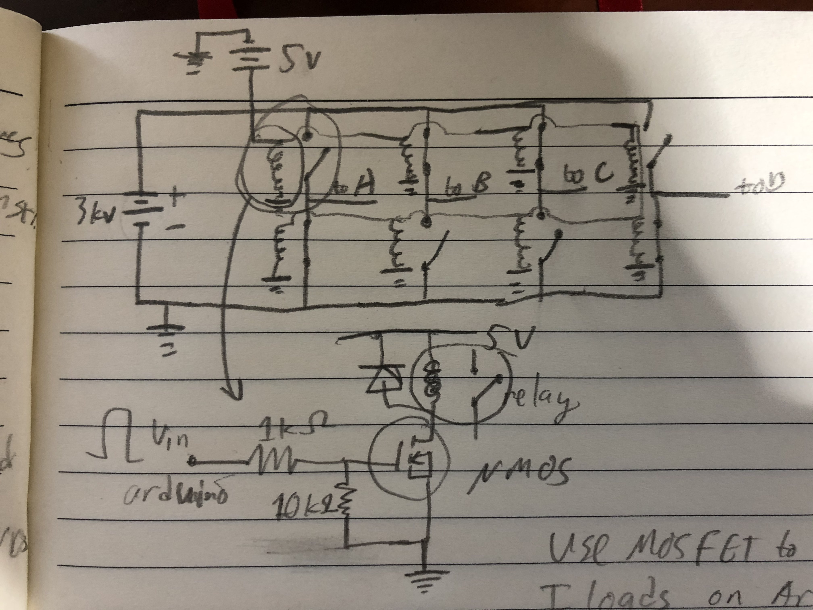
Electrical
Power Supply and Switching
04/09/21
Kemal Pulungan
Technical Updates
Relays for the first prototype, due to difficulty in designing solid-state switching circuit
Ordered components

Slide 2
Electrical
Power Supply and Switching
04/09/21
Kemal Pulungan
Next Steps
4-16 to 4-23: Design PCB and protections against the risks of high voltage
4-23 to 4-30: Overseeing construction of the first board (will not be in-person)
Afterwards up to mid-May: Testing of electronics

